Slide 1

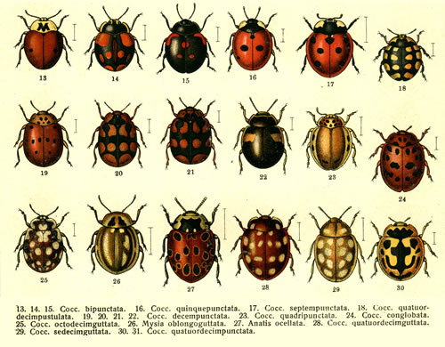
Data Types
Introduction to Computer Science
Reichman University
Lecture 1-2

Slide 2
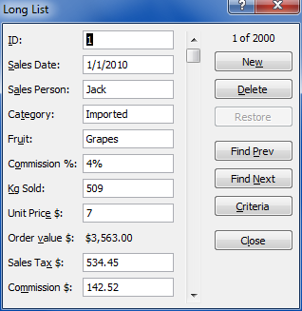
Data
salesDate = ”1/1/2010”;
salesPerson = ”Jack”;
...
commission = 0.04;
kgSold = 509;
unitPrice = 7;
...
orderSent = true;
...
...
10100011001110011100110011001100
10101010010101010101001001010100
11101010010101001010101001010100
11110010100101010101001010010100
11101010010100101001010010100010
00000001001001000010100101010010
10100011001110011100110011001100
11101010010101001010101001010100
11110010100101010101001010010100
11101010010100101001010010100010
00000001001001000010100101010010
10100011001110011100110011001100
10101010010101010101001001010100
11110010100101010101001010010100
...
User view
Images on the screen
Programmer view
Data is manipulated using variables, statements, ...
Computer view
Data is represented as 0’s and 1’s (bits)
Different representations of the same data
Notes:
declaration: Java is strongly-typed, must specify type of each variable (avoid multiplying a string with a real number) Why?
variable: name to refer to data type value
assignment statement: changes the value of a variable

Slide 3
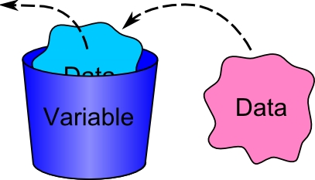
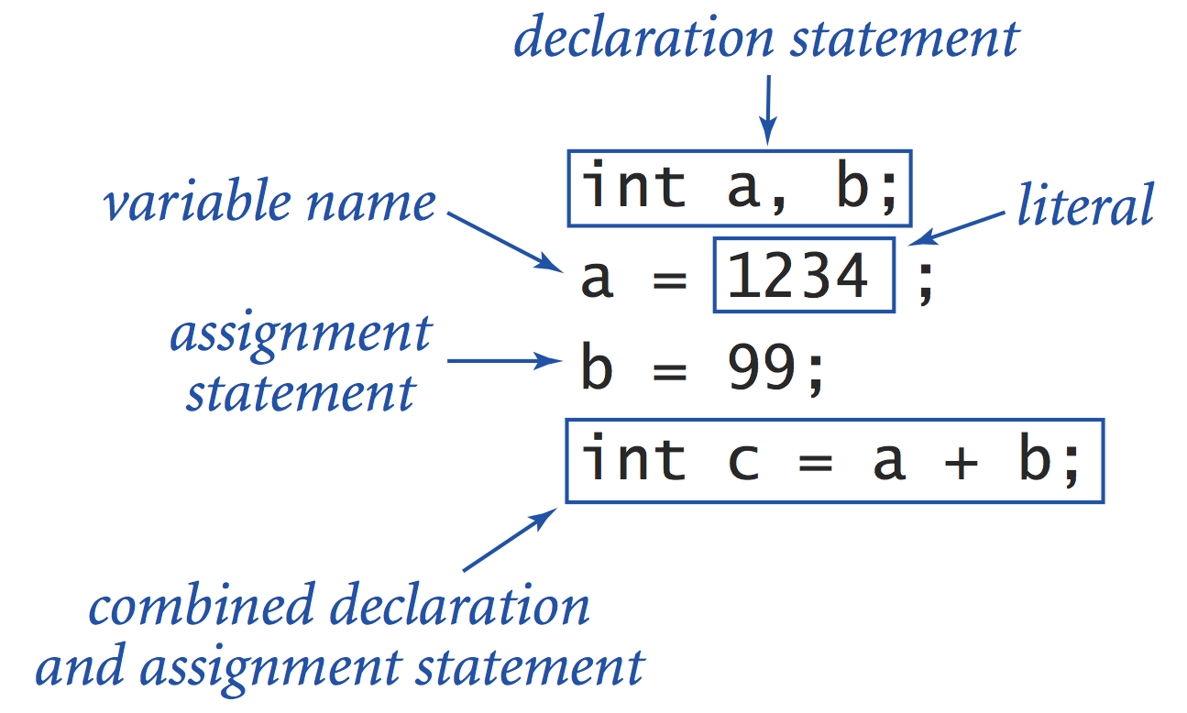
Variables
Variable: a container that has a name, a type, and a value
Examples:
int x = 17; // a variable of type int, now holding the value 17
String city = "Herzliya"; // a variable of type String, now holding the value "Herzliya"
double sum = 5012.35; // a variable of type double, now holding the value 5012.35
Code examples:
…
int a, b;
a = 1234;
b = 99;
int c = a + b;
…
Variable declaration: a statement that creates (and initializes) a variable
Assignment: a statement that assigns a value to a variable.
Notes:
declaration: Java is strongly-typed, must specify type of each variable (avoid multiplying a string with a real number) Why?
variable: name to refer to data type value
assignment statement: changes the value of a variable

Slide 4
Data types
Variable: an abstract container that has a name, a type, and a value
Examples:
int x = 17; // a variable of type int, now holding the value 17
String city = "Herzliya"; // a variable of type String, now holding the value "Herzliya"
double sum = 5012.35; // a variable of type double, now holding the value 5012.35
Code examples:
…
int a, b;
a = 1234;
b = 99;
int c = a + b;
…
Variable declaration: a statement that creates, and optionally initializes, a variable
Assignment: a statement that assigns a value to a variable.
Notes:
declaration: Java is strongly-typed, must specify type of each variable (avoid multiplying a string with a real number) Why?
variable: name to refer to data type value
assignment statement: changes the value of a variable

Slide 5
Data types
Data type: Set of possible values, and operations
Primitive types
Primitive types
type | set of values | example values | typical operations
int | integer numbers | 17 -5034 | add, subtract, multiply, divide
double | floating point numbers | 3.1415 -171.19 | add, subtract, multiply, divide
boolean | truth values | true false | and, or, not
char | characters | 'c' 'K' '?' '5' '+' | compare
...
Represent “scalar” / single values
The Java language features eight primitive data types
Built-into the language
Notes:
declaration: Java is strongly-typed, must specify type of each variable (avoid multiplying a string with a real number) Why?
variable: name to refer to data type value
assignment statement: changes the value of a variable

Slide 6
Data types
Data type: Set of possible values, and operations
Primitive types
type | set of values | example values | typical operations
int | integer numbers | 17 -5034 | add, subtract, multiply, divide
double | floating point numbers | 3.1415 -171.19 | add, subtract, multiply, divide
boolean | truth values | true false | and, or, not
char | characters | 'c' 'K' '?' '5' '+' | compare
...
Represent “scalar” / single values
The Java language features eight primitive data types
Built-into the language
type | set of values | example values | typical operations
String | sequences of characters | "xckd” "hello world" | concatenate
Date | dates | 03/11/2018 | equals, greater than, less than
...
Object types
Represent “aggregates” of values
Java libraries feature many object types
More object types can be created, as needed
Notes:
declaration: Java is strongly-typed, must specify type of each variable (avoid multiplying a string with a real number) Why?
variable: name to refer to data type value
assignment statement: changes the value of a variable

Slide 7
Variables
Abstraction
A container that has three properties: name, type, value
public class Demo1 {
public static void main(String[] args) {
int x; // state 0
x = -13; // state 1
x = 25; // state 2
x = x + 1; // state 3
int y = x - 5; // state 4
}
}
Implementation
A physical memory location, assigned to represent the variable
Memory
x
0
x
-13
x
25
x
26
x
26
y
21
…
…
…
…
…
state 0
state 1
state 2
state 3
state 4

Slide 8
Variables
Abstraction
A container that has three properties: name, type, value
public class Demo1 {
public static void main(String[] args) {
int x; // state 0
x = -13; // state 1
x = 25; // state 2
x = x + 1; // state 3
int y = x - 5; // state 4
}
}
Implementation (bits...)
A physical memory location, assigned to represent the variable, contains bits
Memory
x
00000000
x
11110011
x
00011001
x
00011010
x
00011010
y
00011011
…
…
…
…
…
state 0
state 1
state 2
state 3
state 4

Slide 9
Variable declaration
Examples:
Syntax:
int weight;
type varName;
int x1, x2, n;
type varName1, varName2 ... ;
int z = x + y;
type varName = expression;
Variables are declared (typed and and named) by the programmer, anywhere in the program, as needed
Can only hold data of the declared type.

Slide 10
The assignment operation
Examples:
Syntax:
int x = 5, y = 9;
...
x = -3;
...
y = x;
...
x = y * y - 10 / x + 17;
...
int celsius, f;
f = 120;
celsius = (f - 32) * 5 / 9;
...
variableName = expression;
Assignment anatomy:
The expression on the right hand side is evaluated
The resulting value is assigned to the variable on the left hand side, overwriting its current value
(some languages use let, to make the syntax more explicit:
let variableName = expression; )
f: a badly named variable
Notes
Variable names (and program readability) are critically important
The assignment operator ‘=‘ has nothing to do with algebra’s ‘=‘
What happens if the type of the right hand side does not match the variable’s type? More about this, later.

Slide 11

Lecture plan
Variables
Representing integers: int
Representing text: String
Representing real numbers: double
Representing logical values: boolean
Casting (“data type conversions”)

Slide 12
Integer numbers
...
-4 -3 -2 -1 0 1 2 3 4
...
Java data types for integers
byte: (8 bits), stores integers from -128 to 127
short: (16 bits), stores integers from -32,768 to 32,767
char: (16 bits), stores integers from 0 to 65535 (used to represent characters, later)
int: (32 bits), stores integers from -2,147,483,648 to 2,147,483,647
long: (64 bits), stores integers from -9,223,372,036,854,775,808 to 9,223,372,036,854,775,807
As a convention, in this course we’ll represent integer numbers using int)
Typical operations
a + b Addition
a – b Subtraction
a * b Multiplication
a / b Integer division
a % b Modulo (remainder)
Notes:
asymmetry in smallest and biggest integer deferred for now, as is dealing with negative integers using 2's complement notation
for now, focus on using integers and appreciate that it doesn't matter so much how they are represented internally
Useful for expressing algorithms.
Values: integers between –2147483648 and 2147483647.

Slide 13
Integer expressions
public class Demo2 {
public static void main(String[] args) {
System.out.println(5 + 3); // 8
System.out.println(5 - 3); // 2
System.out.println(5 * 3); // 15
System.out.println(5 / 5); // 1
System.out.println(5 % 3); // 2
System.out.println(1 / 0); // Run-time error

Slide 14
Integer expressions
public class Demo2 {
public static void main(String[] args) {
System.out.println(5 + 3); // 8
System.out.println(5 - 3); // 2
System.out.println(5 * 3); // 15
System.out.println(5 / 5); // 1
System.out.println(5 % 3); // 2
System.out.println(1 / 0); // Run-time error
System.out.println(3 * 5 - 2); // 13 (* has precedence)
System.out.println(3 + 5 / 2); // 5 (/ has precedence)
System.out.println(3 - 5 - 2); // -4 (- associates to the left)
System.out.println((3 - 5) - 2); // -4 (better style)
System.out.println(3 - (5 - 2)); // 0 (parentheses have precedence)
}
}

Slide 15
Lecture plan
Variables
Representing integers: int
Representing text: String
Representing real numbers: double
Representing logical values: boolean
Casting (“data type conversions”)

Slide 16
Textual information
Text:
DNA:
HTML:
We hold these truths to be self-evident, that all men are created equal, that they are endowed by their Creator with certain unalienable Rights, that among these are Life, Liberty and the pursuit of Happiness. That to secure these rights, Governments are instituted among Men, ...
Java:
Java represents a aequence of characters
using a data type called String
String textSegment =
"We hold these truths ...";
String dnaSegment = "ATGTTGCGGCTCGGGGCCAA ...";
String HTMLSegment =
"<!DOCTYPE html> <html lang=\"en-US\"> ...";

Slide 17
Strings
Common operation: concatenation
public class Demo3 {
public static void main(String[] args) {
String s1 = "Tel";
String s2 = "Aviv";

Slide 18
Strings
Common operation: concatenation
public class Demo3 {
public static void main(String[] args) {
String s1 = "Tel";
String s2 = "Aviv";
System.out.println(s1 + s2); // "TelAviv"
System.out.println(s2 + s1); // "AvivTel"
System.out.println(s1 + " " + s2); // "Tel Aviv"

Slide 19
Strings
Common operation: concatenation
public class Demo3 {
public static void main(String[] args) {
String s1 = "Tel";
String s2 = "Aviv";
System.out.println(s1 + s2); // "TelAviv"
System.out.println(s2 + s1); // "AvivTel"
System.out.println(s1 + " " + s2); // "Tel Aviv"
System.out.println(s1 + 3); // "Tel3"
When a String value is concatenated with another value of any data type:
The compiler casts the other value as a String
The type of the resulting expression is a String

Slide 20
Strings
Common operation: concatenation
public class Demo3 {
public static void main(String[] args) {
String s1 = "Tel";
String s2 = "Aviv";
System.out.println(s1 + s2); // "TelAviv"
System.out.println(s2 + s1); // "AvivTel"
System.out.println(s1 + " " + s2); // "Tel Aviv"
System.out.println(s1 + 3); // "Tel3"
System.out.println(6 + 5); // 11
System.out.println("6" + "5"); // "65"
System.out.println("6" + 5); // "65"
System.out.println(2 + " + " + 3 + " = " + (2 + 3)); // "2 + 3 = 5"
}
}
When a String value is concatenated with another value of any data type:
The compiler casts the other value as a String
The type of the resulting expression is a String

Slide 21
Strings
// Illustrates "growing" a string
public class Demo4 {
public static void main(String[] args) {
String s = "1"; // "1"
s = s + " 2 " + s; // "1 2 1"
s = s + " 3 " + s; // "1 2 1 3 1 2 1"
s = s + " 4 " + s; // etc.
System.out.println(s);
}
}
% java Demo4
1 2 1 3 1 2 1 4 1 2 1 3 1 2 1

Slide 22
Command line arguments
public class Demo5 {
public static void main(String[] args) {
// Performs simple arithmetic operations on two command-line atguments
% javac Demo5.java
% java Demo5 5 3
5 + 3 = 8
5 * 3 = 15
5 / 3 = 1
5 % 3 = 2
% java Demo5 12 4
12 + 4 = 16
12 * 4 = 48
12 / 4 = 3
12 % 4 = 0
Inputs can be entered into a program as command-line arguments

Slide 23
Command line arguments
public class Demo5 {
public static void main(String[] args) {
// Performs simple arithmetic operations on two command-line atguments
int a = Integer.parseInt(args[0]);
int b = Integer.parseInt(args[1]);
System.out.println(a + " + " + b + " = " + (a + b));
System.out.println(a + " * " + b + " = " + (a * b));
System.out.println(a + " / " + b + " = " + (a / b));
System.out.println(a + " % " + b + " = " + (a % b));
}
}
% javac Demo5.java
% java Demo4 5 3
5 + 3 = 8
5 * 3 = 15
5 / 3 = 1
5 % 3 = 2
% java Demo5 12 4
12 + 4 = 16
12 * 4 = 48
12 / 4 = 3
12 % 4 = 0
Inputs can be entered into a program as command-line arguments
Convention: The command-line arguments are named args[0], args[1], args[2], …
The entered values (say, 12 4) are treated as Strings ("12","4").
Integer.parseInt(String): A function that returns the string as an int, part of a Java class library named Integer.

Slide 24
Lecture plan
Variables
Representing integers: int
Representing text: String
Representing real numbers: double
Representing logical values: boolean
Casting (“data type conversions”)

Slide 25
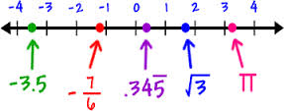
Real Numbers
Java data types for approximating real numbers
float: Uses 32 bits, represents values up to 7 digits after the decimal point
double: Uses 64 bits, represents values up to 15 digits after the decimal point
As a convention, in this course we’ll represent real numbers using double

Slide 26
The double data type
3.141 + 0.03 // 3.171
3.141 - .03 // 3.111

Slide 27
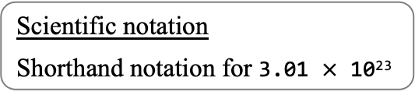
The double data type
3.141 + 0.03 // 3.171
3.141 - .03 // 3.111
6.02e23 / 2 // 3.01E23
Scientific notation
Shorthand notation for 3.01 $×$ 10²³

Slide 28
The double data type
3.141 + 0.03 // 3.171
3.141 - .03 // 3.111
6.02e23 / 2 // 3.01E23
5.0 / 2.0 // 2.5
5 / 2 // 2
5.0 / 2 // 2.5
5 / 2.0 // 2.5
1 / 3 // 0
1.0 / 3.0 // 0.3333333333333333
1.0 / 0.0 // Infinity
1 / 0 // Runtime error
Math.sqrt(2.0) // 1.4142135623730951
Math.sqrt(-1.0) // NaN (Not a Number)
Scientific notation
Shorthand notation for 3.01 $×$ 10²³
Type of x op y ( op being +, -, *, / ) :
If either x or y is double, the resulting type is double
Observations
Computers represent real numbers using finite numerals like 3.141592653589793
Therefore, most real numbers are not represented accurately
For example, 1/3 is represented as 0.333333333333333
Can lead to exotic bugs (discussed later).

Slide 29
The double data type
// Illustrates expressions that use double values.
public class Demo6 {
public static void main(String[] args) {
System.out.println(3.141 + .03); // 3.171
System.out.println(3.141 - .03); // 3.111
System.out.println(6.02e23 / 2); // 3.01E23
System.out.println(5.0 / 2.0); // 2.5
System.out.println(5 / 2); // 2
System.out.println(5.0 / 2); // 2.5
System.out.println(5 / 2.0); // 2.5
System.out.println(1 / 3); // 0
System.out.println(1.0 / 3.0); // 0.3333333333333333
System.out.println(1.0 / 0.0); // Infinity
System.out.println(1 / 0); // Runtime error
System.out.println(Math.sqrt(2.0)); // 1.4142135623730951
System.out.println(Math.sqrt(-1.0)); // NaN
}
}
(Same examples in executable form)

Slide 30
Example: Solve the quadratic equation x² + bx + c = 0
Inputs: b and c (assumption: the coefficient of x² is 1)
Notes:
DO DEMO LIVE
first two error messages are not too difficult, last one requires some explanation

Slide 31
Example: Solve the quadratic equation x² + bx + c = 0
Inputs: b and c (assumption: the coefficient of x² is 1)
x² – 3x + 2
% java Quad1 –3.0 2.0
2.0
1.0
the two solutions
command-line arguments
Notes:
DO DEMO LIVE
first two error messages are not too difficult, last one requires some explanation

Slide 32
Example: Solve the quadratic equation x² + bx + c = 0
Inputs: b and c (assumption: the coefficient of x² is 1)
x² – 3x + 2
% java Quad1 –3.0 2.0
2.0
1.0
% java Quad1 –1.0 –1.0
1.618033988749895
-0.6180339887498949
the two solutions
command-line arguments
x² – x - 1
Notes:
DO DEMO LIVE
first two error messages are not too difficult, last one requires some explanation

Slide 33
Example: Solve the quadratic equation x² + bx + c = 0
Inputs: b and c (assumption: the coefficient of x² is 1)
x² – 3x + 2
% java Quad1 –3.0 2.0
2.0
1.0
% java Quad1 –1.0 –1.0
1.618033988749895
-0.6180339887498949
% java Quad1 1.0 1.0
NaN
NaN
the two solutions
command-line arguments
x² – x - 1
x² + x + 1
not a number
Notes:
DO DEMO LIVE
first two error messages are not too difficult, last one requires some explanation

Slide 34
Example: Solve the quadratic equation x² + bx + c = 0
Inputs: b and c (assumption: the coefficient of x² is 1)
x² – 3x + 2
% java Quad1 –3.0 2.0
2.0
1.0
% java Quad1 –1.0 –1.0
1.618033988749895
-0.6180339887498949
% java Quad1 1.0 1.0
NaN
NaN
% java Quad1 1.0 hello
java.lang.NumberFormatException: hello
% java Quad1 1.0
java.lang.ArrayIndexOutOfBoundsException
the two solutions
command-line arguments
x² – x - 1
x² + x + 1
not a number
invalid argument
missing argument
Error messages can be cryptic;
But, they actually make sense, and one gets used to them.
Notes:
DO DEMO LIVE
first two error messages are not too difficult, last one requires some explanation

Slide 35
Example: Solve the quadratic equation x² + bx + c = 0
Inputs: b and c (assumption: the coefficient of x² is 1)
public class Quad1 {
// Computes the roots of the equation x^2 + bx + c = 0
public static void main(String[] args) {
// Gets and parses b and c from the command-line
double b = Double.parseDouble(args[0]);
double c = Double.parseDouble(args[1]);
// Calculates the roots
double discriminant = b * b - 4.0 * c;
double d = Math.sqrt(discriminant);
double root1 = (-b + d) / 2.0;
double root2 = (-b - d) / 2.0;
// Prints the roots
System.out.println(root1);
System.out.println(root2);
}
}
Calling a function from Java’s Double library
Calling a function from Java’s Math library
Calling a function from Java’s System library
In any programming language, a lot of action is done by functions that are called from libraries. The libraries are classes that extend the basic language.
Notes:
opportunity to point of operator precedence: b*b – 4*c is (b*b) – (4*c)
Note: coefficient of x^2 term = 1 for simplicity

Slide 36
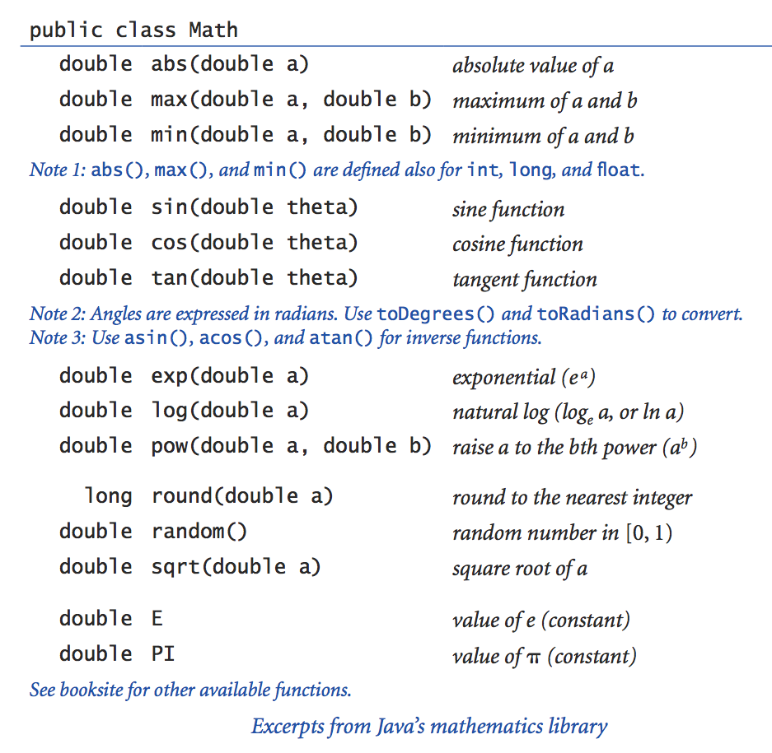
Java’s Math library
Offers common math functions:
Notes:
Why do you think there is there a leap year? Anticipate weird answers.

Slide 37
Java’s Math library
Offers common math functions:
Notes:
Why do you think there is there a leap year? Anticipate weird answers.

Slide 38
Java’s Math library
Offers common math functions:
Notes:
Why do you think there is there a leap year? Anticipate weird answers.

Slide 39
Java’s Math library
Offers common math functions:
Notes:
Why do you think there is there a leap year? Anticipate weird answers.

Slide 40
Java’s Math library
Offers common math functions:
Notes:
Why do you think there is there a leap year? Anticipate weird answers.

Slide 41
Math.random()
A function that returns a pseudo-random double value, distributed uniformly in the interval [0,1)
public class Demo7 {
public static void main(String[] args) {
// prints a random value in [0,1)
double x = Math.random();
System.out.println(x);
% javac Demo7.java
% java Demo7
0.43628266723130604

Slide 42
Math.random()
A function that returns a pseudo-random double value, distributed uniformly in the interval [0,1)
public class Demo7 {
public static void main(String[] args) {
// prints a random value in [0,1)
double x = Math.random();
System.out.println(x);
// prints a random value in [0,2)
System.out.println(2.0 * Math.random());
// prints a random value in [-1,+1)
System.out.println(2.0 * Math.random() - 1.0);
}
}
% javac Demo7.java
% java Demo7
0.43628266723130604
1.86291944429295026
-0.62346234623466346

Slide 43
Math.random()
A function that returns a pseudo-random double value, distributed uniformly in the interval [0,1)
public class Demo7 {
public static void main(String[] args) {
// prints a random value in [0,1)
double x = Math.random();
System.out.println(x);
// prints a random value in [0,2)
System.out.println(2.0 * Math.random());
// prints a random value in [-1,+1)
System.out.println(2.0 * Math.random() - 1.0);
}
}
% javac Demo7.java
% java Demo7
0.43628266723130604
1.86291944429295026
-0.62346234623466346
% java Demo7
0.63453463443333444
0.88666695959595995
0.773688444443443434
Each program run produces (with high likelihood...) different results.

Slide 44
Lecture plan
Variables
Representing whole, signed numbers: int
Representing text: String
Representing real numbers: double
Representing logical values: boolean
Casting (“data type conversions”)

Slide 45
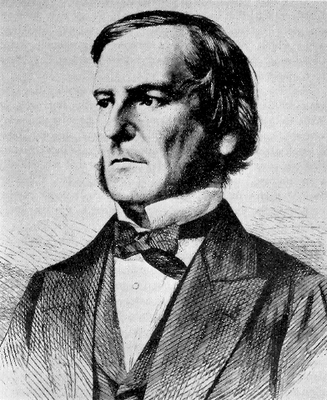
Booleans
George Boole
(1815-1864)
Described a 2-valued calculus now called “Boolean logic”

Slide 46
Booleans
Boolean logic is used for:
Representing and evaluating logical expressions. Example: (speed > 120)
Controlling program flow. Example: if (speed > 120) {
giveTicket(licenseNumber) }
The boolean data type
Two values only:
true
false

Slide 47
The boolean data type
Examples
...
String city = "";
int age = 0;
// Gets city and age data from the user (code omitted)
// Checks city
if (city == "Tel Aviv") System.out.println("you are paying too much rent");
// Checks age
if (age < 18) System.out.println("you are too young for this");

Slide 48
The boolean data type
Examples
...
String city = "";
int age = 0;
// Gets city and age data from the user (code omitted)
// Checks city
if (city == "Tel Aviv") System.out.println("you are paying too much rent");
// Checks age
if (age < 18) System.out.println("you are too young for this");
// Same effect (more efficient if we have to age-check many times):
boolean tooYoung = age < 18;
if (tooYoung) System.out.println("you are too young for this");
...

Slide 49
The boolean data type
Examples
...
String city = "";
int age = 0;
// Gets city and age data from the user (code omitted)
// Checks city
if (city == "Tel Aviv") System.out.println("you are paying too much rent");
// Checks age
if (age < 18) System.out.println("you are too young for this");
// Same effect (more efficient if we have to age-check many times):
boolean tooYoung = age < 18;
if (tooYoung) System.out.println("you are too young for this");
...
// Checks the parity of x
if ((x % 2) == 0) System.out.println(x + " is even");
else System.out.println(x + " is odd");
...
The if and if/else statement will be discussed in the next lecture.

Slide 50
Boolean operators
Examples
(b * b – 4.0 * a * c) >= 0 // Nonnegative?
(year % 100) == 0 // Beginning of a century?
x != 1 // Not equal 1?

Slide 51
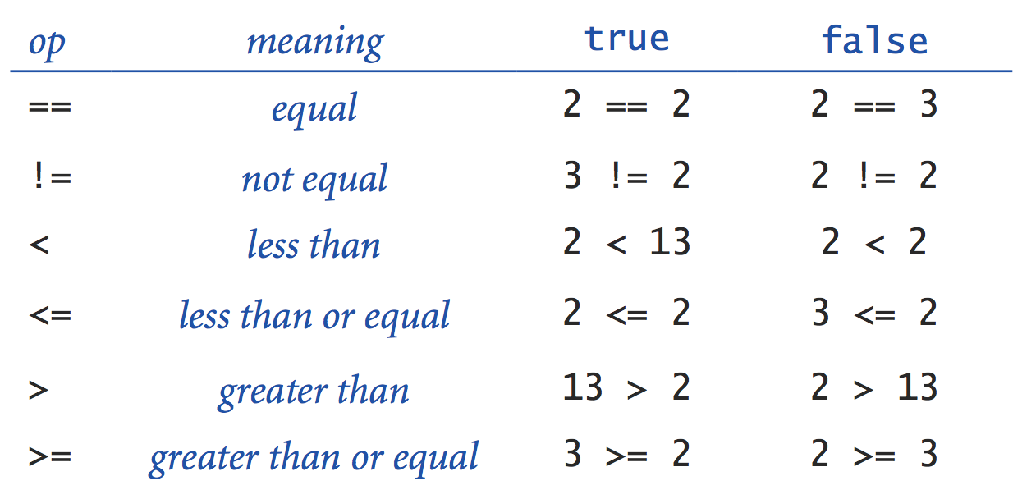
Boolean operators
Examples
(b * b – 4.0 * a * c) >= 0 // Nonnegative?
(year % 100) == 0 // Beginning of a century?
x != 1 // Not equal 1?
Boolean expressions: x op y where: x and y are compatible Java expressions and op is ==, !=, <, <=, >, >=

Slide 52
Boolean connectors (Not, And, Or)
! (not)
a
!a
Truth table: gives the output of a Boolean function (in this case, Not, And, Or) for every possible input
false
true
true
false
&& (and)
|| (or)
a
b
a && b
a
b
a || b
false
false
false
false
false
false
false
true
false
false
true
true
true
false
false
true
false
true
true
true
true
true
true
true
In other words
!a is true iff a is false
(a && b) is true iff both a and b are true
(a || b) is true iff either a or b or both are true

Slide 53
Example: leap year
Task: determine if a given year is a leap year (שנה מעוברת)
Rule: yes if the year is (i) divisible by 400 or (ii) divisible by 4 but not by 100
public class LeapYear {
public static void main(String[] args) {
int year = Integer.parseInt(args[0]);
boolean isLeapYear;
// Checks if the year is divisible by 400
isLeapYear = ((year % 400) == 0);
// Then checks if the year is divisible by 4 but not by 100
isLeapYear = isLeapYear || (((year % 4) == 0) && ((year % 100) != 0)));
System.out.println(isLeapYear);
}
}
% java LeapYear 2020
true
% java LeapYear 1900
false
% java LeapYear 2028
true

Slide 54
Example: leap year
Task: determine if a given year is a leap year (שנה מעוברת)
Rule: yes if the year is (i) divisible by 400 or (ii) divisible by 4 but not by 100
public class LeapYear {
public static void main(String[] args) {
int year = Integer.parseInt(args[0]);
boolean isLeapYear;
// Checks if the year is divisible by 400
isLeapYear = ((year % 400) == 0);
// Then checks if the year is divisible by 4 but not by 100
isLeapYear = isLeapYear || (((year % 4) == 0) && ((year % 100) != 0));
System.out.println(isLeapYear);
}
}
// Same as:
leapYear = ((year % 400) == 0) || ((year % 4) == 0) && ((year % 100) != 0));

Slide 55
Lecture plan
Variables
Representing whole, signed numbers: int
Representing text: String
Representing real numbers: double
Representing logical values: boolean
Casting (also known as “data type conversions”)

Slide 56
Casting
What happens when we create an expression made of different data types?
In some cases Java handles the resulting type implicitly (example: 5.0 / 2)
In other cases the programmer must handle the resulting type explicitly
Implicit casting (examples)
"1234" + 99 // "123499" (String)
11 * 0.3 // 3.3 (double)
Explicit casting (examples)
Integer.parseInt("123") // 123 (int)
(int) 2.71828 // 2 (int)
(int) 11 * 0.3 // 3.3 (double)
(11 * (int) 0.3) // 0 (int)
(int) (11 * 0.3) // 3 (int)

Slide 57
Casting
What happens when we create an expression made of different data types?
In some cases Java handles the resulting type implicitly (example: 5.0 / 2)
In other cases the programmer must handle the resulting type explicitly
public class Demo8 {
public static void main(String[] args) {
System.out.println("1234" + 99); // "123499" (String)
System.out.println(11 * 0.3); // 3.3 (double)
System.out.println(Integer.parseInt("123")); // 123 (int)
System.out.println((int) 2.71828); // 2 (int)
System.out.println((int) 11 * 0.3); // 3.3 (double)
System.out.println((11 * (int) 0.3)); // 0 (int)
System.out.println((int) (11 * 0.3)); // 3 (int)
}
}
(Same examples in executable form)

Slide 58
Casting
Example: generate a random integer in the range [0,N), where N is a command-line argument
Basic idea: Use Math.random() to create a random double value in [0,1), then manipulate this value to create an int in the range [0,N).
public class RandomInt {
// Generates a random integer from 0,...,N-1
public static void main(String[] args) {
// Gets N from the user
int N = Integer.parseInt(args[0]);
double r = Math.random();
int n = (int) (r * N);
System.out.println("random integer is " + n);
}
}
Explicit casting: args[0], which is a String, is cast as int, using a function call.
% java RandomInt 10
random integer is 6
% java RandomInt 10
random integer is 2
% java RandomInt 35
random integer is 32
% java RandomInt 10000
random integer is 2184
Explicit casting: Converts the value on the right to an int (ignoring the value after the decimal point)
Implicit casting: double * int gives double
Implicit casting: String + int gives String

Slide 59


Summary
Java data types (discussed in this lecture)
int, double for mathematical calculations
String for text processing
boolean for logical expression and controlling program flow
. . .
Java is a “strongly-typed” language
Variables must be declared before they are used, and proper use is checked by the compiler
When needed, type conversion is done either
implicitly (by the compiler), or
explicitly (by the programmer)
Watch out:
Programmers must be alert to potential exotic bugs resulting from implicit casting
Arianne 5 rocket crash (1996):
Cause: type cast error.

Slide 60
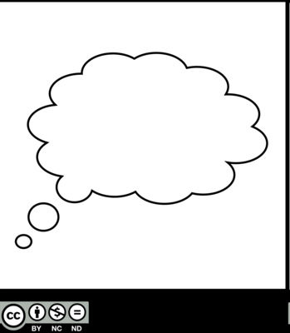
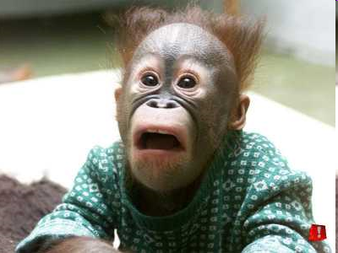

Overflow and rounding off errors
what’s going on?
public class Demo9 {
public static void main(String[] args) {
System.out.println(100000 * 100000 * 100000);
System.out.println(1.03 - 0.42);
System.out.println(1.00 - 9 * .10);
System.out.println((0.7 + 0.1) == (0.9 - 0.1));
}
}
Expected results
Actual results
% java Demo9
-1530494976
0.6100000000000001
0.09999999999999998
false
What to do?
Be aware
Study the application’s requirements
If necessary, write code that handles rounding-off errors
Test extreme values
If exact values are important, there are solutions. But, these solutions may make the program less efficient.
% java Demo9
1000000000000000
0.61
0.1
true
Explanation: Computers represent numbers using a fixed number of bits (0’s and 1’s). Results:
Overflow / underflow
Many real values are not represented accurately.

Slide 61
Lecture plan
Variables
Representing whole, signed numbers: int
Representing text: String
Representing real numbers: double
Representing logical values: boolean
Casting (“data type conversions”)

Slide 62
Data Types
Introduction to Computer Science
Reichman University
Lecture 1-2

